Slide 1

Application-Aware Scheduling
in Deep Learning Software Stacks
Oral Defense
May 5th, 2022
Student:
Committee:
Peifeng Yu
Assistant Professor Mosharaf Chowdhury (Chair)
Associate Professor Karthik Duraisamy
Associate Professor Xin Jin
Assistant Professor Baris Kasikci
Notes:
Good morning, everyone, and good evening, for people on the other side of the world, my name is [name].
Thanks for attending my defense, and welcome.
So my thesis is centered around the topic of ..

Slide 2
Deep Learning Becomes Ubiquitous
Computer vision
Natural language processing
Autonomous vehicles
Recommendation system
Applications
Intelligent assistant: Google, Siri, Cortana
Face recognition
Video content understanding
Motivations | Salus | Fluid | Orloj | Conclusion
Notes:
DL becomes ubiquitous in its adoption in many data-driven tasks, …
While it is easier than ever to run state-of-the-art DL models on pre-packaged datasets, the infrastructure that supports DL in real-world applications is still in its early stages and becoming increasingly a major bottleneck.
Let’s take a closer look at what this infrastructure is about

Slide 3







Deep Learning Infrastructure as a Stack
Applications
Hyperparameter Tuning
Data Preprocessing
Model Serving
High-level
TensorFlow Serving
Model Training
DL Framework/Compiler/Runtime
Low-level
TensorRT
Hardware
CPU
GPU
TPU
ASIC
…
Motivations | Salus | Fluid | Orloj | Conclusion
Notes:
The first layer below applications are high-level frameworks.
Categorizing by use cases, we roughly have a split of the ecosystem between model training and model serving, because they have different sets of goals.
Model training values throughput and the ease of development, while model serving has constraints like latency or utilization.
Example frameworks in this space are Ray and its sister project Tune, Keras; Tensorflow Serving, Clipper
These high-level frameworks, again rely on a set of common low-level frameworks, like Tensorflow/pytorch, or the new kid on the block, DL compiler and separate runtimes like TVM, TensorRT, ONNXRuntime.
These low level infrastructures provides common abstraction over hardware, CPU, GPU, etc.

Slide 4
Emerging Trends in DL Stack
Challenges
Scheduling with the cluster & lower-level remains unchanged
Abstraction remains minimal in functionality and flexibility
New applications beyond long-running batch processing jobs
New metrics beyond predictive accuracy
Hyperparameter Tuning
Data Preprocessing
Model Serving
High-level
Model Training
DL Framework/Compiler/Runtime
Low-level
New types of hardware beyond CPU
Hardware
CPU
GPU
TPU
ASIC
…
Motivations | Salus | Fluid | Orloj | Conclusion
Notes:
We identify 3 emerging trends that are creating challenges especially at the boundaries between layers
First, there are new application use cases beyond long-running batch processing jobs: however, their scheduling with respect to the cluster and lower level frameworks remain largely unchanged. There are therefore missing optimization opportunities from leveraging those application’s unique runtime characteristics.
Then, there are distinctly new types of hardware beyond CPU, but the abstraction layer, which is usually low-level frameworks, remain minimal in functionality and flexibility, compared with the situation of CPU and OS kernel.
Finally,

Slide 5
Emerging Trends in DL Stack
Challenges
Scheduling with the cluster & lower-level remains unchanged
Abstraction remains minimal in functionality and flexibility
Lack of app semantics at lower-level
New applications
New metrics beyond predictive accuracy
Hyperparameter Tuning
Data Preprocessing
Model Serving
High-level
Model Training
DL Framework/Compiler/Runtime
Low-level
New types of hardware
Hardware
CPU
GPU
TPU
ASIC
…
Motivations | Salus | Fluid | Orloj | Conclusion
Notes:
There are new metrics beyond predictive accuracy, like latency, cost, or power efficiency. They urge the app-level context to be available across the stack, so schedulers at lower level can also enforce application defined metrics
All these new trends and challenges leads to my thesis statement

Slide 6
Thesis Statement
There are mismatches among the hardware, DL applications, and the software infrastructure in between.
Revisit the system design across the software stack, focusing on the synergy between schedulers and application/system-specific information.
New applications
New metrics beyond predictive accuracy
High-level
Fluid
Orloj
Low-level
New types of hardware
Salus
Hardware
Motivations | Salus | Fluid | Orloj | Conclusion
Notes:
That is, there is a mismatch …
Therefore in this thesis work, we revisit …
Specifically, to address new hardwares, we developed Salus as a mechanism to provide fine-grained GPU sharing primitives for DL app for improved memory util and scheduling flexibility,
To better handle the new job pattern of hyperparameter tuning tasks, we redesign the execution logic in tuning algorithms with Fluid, which is resource-aware and is able to make use of richer scheduling opportunities, like automatic parallelism, and, as what I just mentioned, GPU sharing
Finally, Orloj brings better inference request scheduling with latency constraints to dynamic neural networks, which breaks the common assumption that request execution time is constant and data-independent

Slide 7
Outline
Salus
Salus
Fine-grained GPU Sharing Primitives for Deep Learning Applications
Fluid
Resource-aware Hyperparameter Tuning Engine
DynInfer
Predictably Serving Unpredictable DNNs
Fluid
Orloj
Motivations | Salus | Fluid | Orloj | Conclusion
Notes:
In the rest of the presentation, I’ll introduce each of the projects, and then conclude.

Slide 8
Outline
Salus
Fine-grained GPU Sharing Primitives for Deep Learning Applications
Fluid
Resource-aware Hyperparameter Tuning Engine
Orloj
Predictably Serving Unpredictable DNNs
Motivations | Salus | Fluid | Orloj | Conclusion
Notes:
Let’s start with salus

Slide 9
Salus
Fine-grained GPU Sharing Primitives
for Deep Learning Applications
Peifeng Yu, Mosharaf Chowdhury
(MLSys’20)
Notes:
… the fine-grained GPU sharing primitives for DL apps

Slide 10
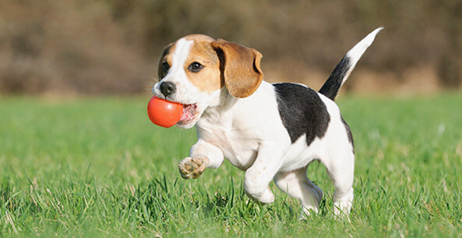
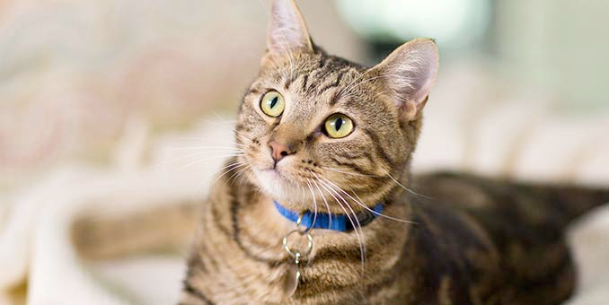

A Brief Introduction to Deep Learning
Training:
Forward & backward pass
Iterative
Errors
Dog
Cat
Raccoon
✔
✔
✗
Motivations | Salus | Fluid | Orloj | Conclusion
Notes:
To make sure everyone is on the same page, let me briefly introduce the training and inference process of a DL model
DL models must be trained to get each layer’s parameters learn a certain task.
Using image classification as an example, training contains a forward pass where images are given as input, going through the network, generating certain results
Then a backward pass happens by calculating the errors and propagating the gradient toward smaller error to all previous layers.
This forward and backward pass happens in an iterative fashion.

Slide 11

A Brief Introduction to Deep Learning
Training:
Forward & backward pass
Iterative
Inference:
Forward pass
Cat
✔
Motivations | Salus | Fluid | Orloj | Conclusion
Notes:
Then there is inference. Since there’s a known set of model parameters. A simple forward pass will give classification result on inputs we give it.

Slide 12

Accelerate Deep Learning with GPUs
 | Neural Networks | GPUs
Inherently Parallel | ✔ | ✔
Matrix Operations | ✔ | ✔
FLOPS | ✔ | ✔
Motivations | Salus | Fluid | Orloj | Conclusion
Notes:
With that out of the way, we notice that GPUs are becoming a popular choice for both training and inference.
Because GPUs are excellent at matrix operations which are the majority of computations involved in DL models

Slide 13
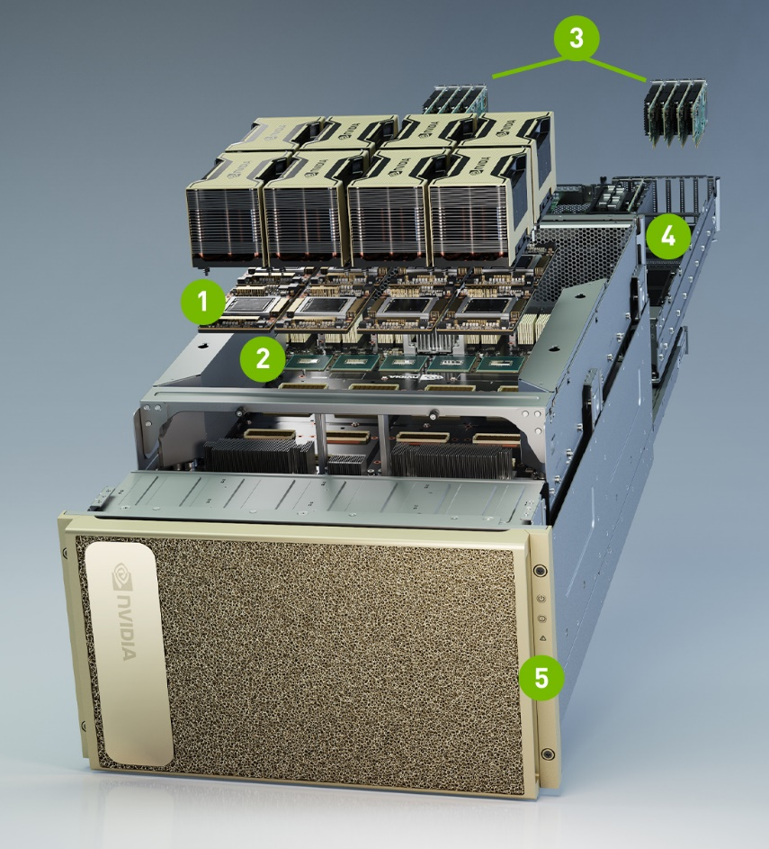

Accelerate Deep Learning with GPUs
Image credit: https://www.nvidia.com/en-us/data-center/v100/, https://www.nvidia.com/en-gb/data-center/dgx-a100/
Motivations | Salus | Fluid | Orloj | Conclusion
Notes:
With that out of the way, we notice that GPUs are becoming a popular choice for both training and inference.
Because they are excellent at matrix operations which are the majority of computations involved in DL models

Slide 14

Exclusive Access to GPU
An application can have multiple GPUs, but each GPU usually belongs to exactly one application at a time
Advantages
Simplifies hardware design
Efficiency
Disadvantages
Lack of flexibility
Motivations | Salus | Fluid | Orloj | Conclusion
Notes:
Unfortunately, the minimum granularity of GPU allocation is often the entire GPU: …
While this has the advantages of simpler hardware design and higher efficiency, it lacks flexibility in many aspects.

Slide 15
Exclusive Access: Lack of Flexibility
Hinders the scheduling ability of GPU cluster managers
Starting or suspending job is expensive
Often easier to just do non-preemptive scheduling → FIFO
Head-of-line blocking
Motivations | Salus | Fluid | Orloj | Conclusion
Notes:
We focus on 2 consequences caused by this lack of flexibility:
The first is that it hinders the scheduling ability of GPU cluster managers: with exclusive access, starting or suspending job takes long time, it is often easier to just do the simple non-preemptive scheduling FIFO, which comes with its well-known drawback of HOL blocking.

Slide 16
Exclusive Access: Lack of Flexibility
Hinders the scheduling ability of GPU cluster managers
Underutilization
Hyperparameter tuning
Model serving (inference)
Motivations | Salus | Fluid | Orloj | Conclusion
Notes:
The second problem is underutilization. For many scenarios, a single job is relatively small and can’t utilize the whole GPU

Slide 17
Exclusive Access: Lack of Flexibility
Underutilization
Variance in memory usage
Model | Peak Memory Usage
VAE | 28M
Super Resolution | 529M
Deep Speech | 3993M
Inception4 | 11355M
Motivations | Salus | Fluid | Orloj | Conclusion
Notes:
The prime example of the underutilization problem is the memory usage.
Here on the left, I’ve collected the peak memory usage for a various of models. [click] You can see the peak varies from tens of M to tens of G.
Not only is there variance across models, for a single model, during its runtime, it has this kind of peaks and valleys due to its iterative nature.
All those remain underutilized because the GPU is exclusively accessed and can’t be shared with other applications.

Slide 18
How Can We Efficiently Share a GPU for Deep Learning Applications?

Slide 19
GPU Sharing
Existing sharing solutions
Approach | Efficiency | Dynamic Memory | Flexible Scheduling
Static Partitioning (SP) | No | No | Yes
Multi-Process Service (MPS) | Yes | No | No
Approach | Efficiency | Dynamic Memory | Flexible Scheduling
Static Partitioning (SP) | No | No | Yes
Motivations | Salus | Fluid | Orloj | Conclusion
Notes:
Let’s review what can be done with existing solutions.
First, you can statically partition the GPU by manually setting the maximum memory usage for each job, splitting the GPU into partitions. This is flexible in terms of scheduling because the user have the ultimate control of which job to run and when. But it isn’t the most efficient way to run things unfortunately, due to expensive GPU hardware context switches.
There is also NVIDIA’s solution, MPS, that use a single background service to consolidate GPU accesses. But then you are locked to the limited scheduling options provided by MPS. And most importantly, it doesn’t handle memory allocation and you are in the same situation as static partitioning.

Slide 20
Design Goals
Approach | Efficiency | Dynamic Memory | Flexible Scheduling
Approach | Efficiency | Dynamic Memory | Flexible Scheduling
Static Partitioning (SP) | No | No | Yes
Multi-Process Service (MPS) | Yes | No | No
Ideal | Yes | Yes | Yes
Approach | Efficiency | Dynamic Memory | Flexible Scheduling
Static Partitioning (SP) | No | No | Yes
Multi-Process Service (MPS) | Yes | No | No
Minimize deployment overhead
No new hardware
No modification from user side
Motivations | Salus | Fluid | Orloj | Conclusion
Notes:
Ideally, we want something that is both efficient, flexible, and manages memory for us, all while minimizing the deployment overhead. So that means it shouldn’t require new hardware, nor should it require modifications from the user side.

Slide 21
Salus
Fine-grained GPU Sharing Primitives for Deep Learning
A consolidated execution service enabling sharing primitives
Fast job switching,
Memory sharing
without modifying any
User scripts,
Operating systems, or
Hardware
with the goal to
Support new schedulers for GPUs,
Improve GPU utilization
Notes:
Enter Salus, that is a consolidated execution service, providing two missing GPU sharing primitives:
Fast job switching and memory sharing.
It does this without modifying any user scripts, OS or hardware, with the goal to support new schedulers for GPUs and improve the GPU utilization.
So how does Salus interact with the rest of ecosystem?

Slide 22
Salus in DL Stack
User scripts
Deep Learning Frameworks
Tensorflow
PyTorch
MxNet
Others
Salus Adaptor
Deep Learning Frameworks
…
Salus Execution Service
Salus Execution Service
CPU
GPU
FPGA
ASIC
…
Motivations | Salus | Fluid | Orloj | Conclusion
Notes:
It actually sits in between common DL frameworks and the hardware, with 2 components.
Adaptor: transfers computation graph
Execution service: consolidates all GPU access and does the scheduling

Slide 23
Sharing Primitives
Efficient job switching
Memory sharing: GPU lane abstraction
Deep Learning Frameworks
Motivations | Salus | Fluid | Orloj | Conclusion
Notes:
Let’s talk about how Salus implements these two sharing primitives

Slide 24
Sharing Primitives
Efficient job switching
Memory sharing: GPU lane abstraction
Deep Learning Frameworks
Motivations | Salus | Fluid | Orloj | Conclusion
Notes:
We’ll focus on the first one in this talk due to time constraints. Those interested can find more details in my thesis or the published paper.

Slide 25
Sharing Primitives: Efficient Job Switching
Essentially swapping jobs in and out
Bottleneck: data transfer (GPU memory to/from system memory)
Deep Learning Frameworks
Motivations | Salus | Fluid | Orloj | Conclusion
Notes:
Job switching is essentially swapping jobs in and out
It is thus bounded by data transfer speed

Slide 26
Understand DL Job Memory
3 types of memory
Model
Ephemeral
Framework-internal
Deep Learning Frameworks
Motivations | Salus | Fluid | Orloj | Conclusion
Notes:
Let’s first understand what data are kept in GPU memory though.
Recall that DL models have the large differences in peak and average memory usage.
They are composed by 3 types of memory
The model memory are typically parameters, and need to be kept across iterations, thus counting towards the average memory usage
The ephemeral memory are typically scratch areas, or intermediate results. They contributes to the peak usage in each iteration, but can be discarded by the end of iteration
Then there’s some miscellaneous framework internal bookkeeping usages.

Slide 27
Understand DL Job Memory
3 types of memory
Model
Ephemeral
Framework-internal
Data transfer time is non-negligible
Can be over 2X of corresponding inference latency
Model memory << GPU memory capacity
Deep Learning Frameworks
Why not keep multiple jobs’ model in memory for fast switching?
Motivations | Salus | Fluid | Orloj | Conclusion
Notes:
The obvious solution to swap jobs is to just transfer the model data, but that still has non-negligible transfer time when compared with inference latency
But on the other hand, model memory is much smaller than capacity
So why not

Slide 28
Sharing Primitives
Job switching is done by determine which job’s iteration to run next
Minimal switching overhead
Flexible scheduling policies
Deep Learning Frameworks
Job 1
Memory
Job 2
Time
Motivations | Salus | Fluid | Orloj | Conclusion
Notes:
That is how switching is done in Salus. The scheduler will determine which job’s iteration to run next. Therefore there are minimal switching overhead because all candidates are already loaded. And because the scheduling is done in software, it is easy to support additional policies.
Efficient job switching basically enables fine-grained time sharing. But for the remaining free space between job’s peak usage and GPU’s capacity,

Slide 29
Sharing Primitives
Memory sharing: GPU lane
Deep Learning Frameworks
Lane 1
Job 1
Job 2
Memory
Job 3
Lane 0
Time
Motivations | Salus | Fluid | Orloj | Conclusion
Notes:
it’s up to the GPU lane abstraction in Salus to manage and place more jobs, achieving space share. Please refer to the paper for details.

Slide 30
Evaluation
Deployed on Intel E5-2670 with NVIDIA Tesla P100 with 15 workloads
Flexible scheduler
Faster hyperparameter tuning
High GPU utilization for inference
Notes:
Let take a look at evaluations, which is done using NVIDIA P100 GPUs with 15 workloads.

Slide 31
A Production Trace
100 jobs from a production trace[1]
4 schedulers implemented as demo
SRTF vs FIFO: 3.19x improvement in Avg. JCT
[1]: G. Juncheng et al. “Tiresias: A GPU Cluster Manager for Distributed Deep Learning”. In: NSDI. 2019.
Motivations | Salus | Fluid | Orloj | Conclusion
Notes:
We’ll first demonstrate the flexibility in scheduler implementation by showing 4 schedulers made possible by Salus
The Job completion time CDF in the bottom are collected from 100 jobs,
arriving online following a production trace.
With the Salus, we are able to implement Shortest-remaining-time-first policy, which achieves over 3 times improvement in avg. JCT

Slide 32
Hyperparameter Tuning
2 sets of hyperparameter tuning tasks
300 exploration jobs in each set
Makespan is important
Motivations | Salus | Fluid | Orloj | Conclusion
Notes:
Then we’ll turn to hyperparameter tuning and see how Salus can improve the makespan
There are 300 exploration jobs in each tuning task. For superres model, Salus is able to finish in half the time due to relatively small model size.
In the case of resnet50, because a single model almost uses up a whole GPU, the improvement isn’t large. But Salus is still able to reduce the idle time between jobs and provide a little speed up.

Slide 33
Pack Inference Applications
42 DL inference applications in 1 GPU
User facing services: latency
Motivations | Salus | Fluid | Orloj | Conclusion
Notes:
Finally, we measure the latency for inference use case
We were able to serve 42 models at the same time in 1 GPU with Salus, with only small overhead in latency. We would have used 42 GPUs if we ran each model separately, or 6 GPUs if MPS was used.

Slide 34



Salus
Fine-grained GPU Sharing Primitives
for Deep Learning
Open sourced at: https://github.com/SymbioticLab/Salus
Prebuilt docker image available
Notes:
To summarize, we develop Salus to provide the missing, fine-grained GPU sharing primitives for deep learning applications.
The project is open sourced on GitHub, and we have prebuilt docker images available.

Slide 35
Outline
Salus
Fine-grained GPU Sharing Primitives for Deep Learning Applications
Fluid
Resource-aware Hyperparameter Tuning Engine
Orloj
Predictably Serving Unpredictable DNNs
Motivations | Salus | Fluid | Orloj | Conclusion
Notes:
Next is fluid

Slide 36
Fluid
Resource-Aware Hyperparameter Tuning Engine
Peifeng Yu†, Jiachen Liu†, Mosharaf Chowdhury
(MLSys’21)
† Equal contribution
Notes:
…a resource-aware hyperparameter tuning engine.

Slide 37
Hyperparameter Tuning Today
Hyperparameters
# of layers/# of neurons
Dropout rate
# of channels
Learning rate
Optimizer parameters
Etc.
Non-differentiable & high dimensional search space
Motivations | Salus | Fluid | Orloj | Conclusion
Notes:
Let’s start with a brief intro of HP tuning today
So what are HPs? ….
There are lots of them, each with certain kind of range, and we want to find the best set for training,
So HP tuning is a search problem
Search space is … & …

Slide 38
Hyperparameter Tuning Today
Evaluation of hyperparameters is time/resource consuming
train a model to know if it works
Many algorithms & techniques
Random/Grid
Model-based config generation
Early stopping/successive halving
Many others
Motivations | Salus | Fluid | Orloj | Conclusion
Notes:
[click] And, how do we evaluate a set of hp config? We train a model and see if it works well.
That’s both time/res consuming
[click]
So naturally there are lots of algo & tech to make the process as efficient as possible
We have the very basic random/grid
More advanced ones that use model-based config generation
There are also other techniques like early stopping, and the well-known one successive halving (/ˈhaviNG/)

Slide 39

Hyperparameter Tuning Today
Hyperparameter Tuning Algorithm
Config Generation
3
trials
1
4
2
Evaluation
Motivations | Salus | Fluid | Orloj | Conclusion
Notes:
How exactly does the tuning process work? Here’s a simple illustration
One the left is a box representing a tuning algorithm, and on the right, a cluster.
[click]
The algorithm generates bunch of hyperparameter configs
[click]
Those are sent to the eval logic, which decides which config to evaluate next
[click]
and give it to the cluster to run, in the form of a training trial.
[click]
When the trial finishes, the result is propagated back,
which may be used to guide future generations, like Bayesian optimization.
That’s the whole picture, and as we can see, the topic of our talk today, trial execution …

Slide 40
Hyperparameter Tuning Today
Hyperparameter Tuning Algorithm
Config Generation
3
trials
1
4
2
& Execution
Evaluation
Direct interaction with the cluster to execute trials
Trials gets executed in FIFO order
Motivations | Salus | Fluid | Orloj | Conclusion
Notes:
… trial execution, is merely a thing that is implicitly defined by the evaluation logic,
In other words, it’s the algo’s solo responsibility to directly instruct the cluster for trial execution.
In most cases, tuning algos do no more than a simple FIFO queue, and forget about it

Slide 41
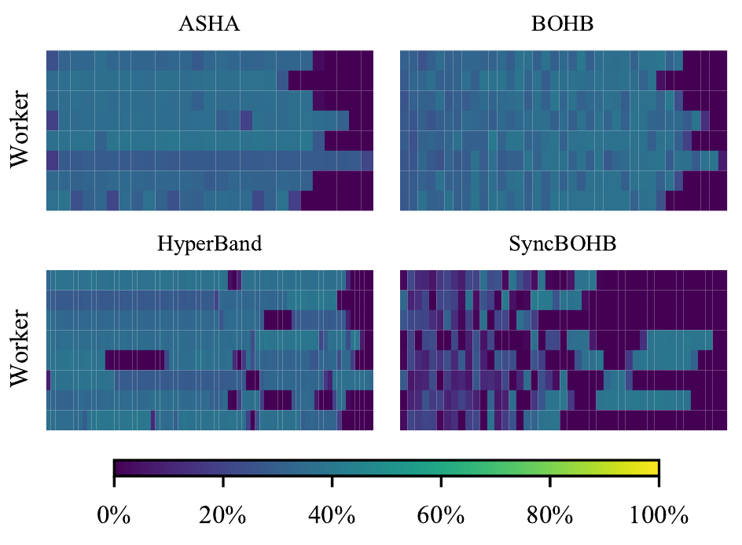
Trials Execution
Resource utilization over time
Time
Time
Time
Time
Motivations | Salus | Fluid | Orloj | Conclusion
Notes:
However, trial execution is not a trivial problem, at all.
Let me show you a GPU utilization heat map of 4 algo tuning a classification model.
The x axis of each heat map is time since started, and each row represents an individual worker. The brighter the color is, the higher utilization the worker is.
Under our measurement, the avg util is in the range of 20-40%, which is far less than ideal.
We can’t really blame the algorithms, though, as there are actually some tricky parts in the execution that could be easily overlooked.

Slide 42
Trials Execution
Lack of elasticity reduces utilization
Existing trials can not easily use new idle workers
High utilization != useful work
Asynchronous Successive Halving (ASHA)
Trial concurrency == # of workers
Can not scale up beyond a certain # of workers
Yet another hyperparameter tuning algorithm?
Motivations | Salus | Fluid | Orloj | Conclusion
Notes:
There are some tricky parts in the execution that could be easily overlooked.
First, most tuning framework defaults to single trial single worker setup, or at most allow distributed training via some custom settings. In either case, the number of workers is statically set, and can’t be changed during runtime
Second, high util doesn’t equal to useful work. For example, in asynchronous successive halving, or ASHA for short, there’s always the same number of trials running as the # of workers.
This is done by starting new base stage trials whenever there’s an idle worker.
This certainly helps improve the utilization, but beyond a certain point, adding more workers doesn’t speed up the algorithm anymore.
Because those extra workers are busy computing trials from the base stage, and those trials are unlikely to be ever used for the final goal.
Now we know some of the tricky details, we can simply come up with “yet another HP tuning algorithm”

Slide 43
Trials Execution
What about existing algorithms?
Mostly still FIFO
Execution is tightly coupled with algorithm
Hard to apply to other algorithms
Hard to improve w/o deep knowledge of the algorithm itself
Motivations | Salus | Fluid | Orloj | Conclusion
Notes:
But that does not help with the ecosystem as a whole very much: most widely used algorithms would still be using FIFO under the hood.
The more fundamental problem is that the execution is still tightly coupled with and implicitly defined by the algorithm, so it’s hard to apply any improvements in one algorithm to another.
And it is hard to improve the algorithm in the first place, without deep knowledge of the algorithm itself.
What else can we do?

Slide 44
All problems in computer science can be solved by another level of indirection
--- Butler Lampson
Notes:
As the saying goes,

Slide 45
Hyperparameter Execution Engine: Fluid
Hyperparameter Tuning Algorithm
Config Generation




trials
Evaluation
Execution
&
Motivations | Salus | Fluid | Orloj | Conclusion
Notes:
That is exactly what we did:
Recall how HP tuning algorithms work, and how they directly talk to the cluster,

Slide 46
Hyperparameter Execution Engine: Fluid
Hyperparameter Tuning Algorithm
Config Generation




Execution
Evaluation
Motivations | Salus | Fluid | Orloj | Conclusion
Notes:
we extract the execution logic and build a dedicated engine that’s specialized to run trials as efficient as possible.
This abstraction layer will handle all trial execution requests for HP tuning algorithms.

Slide 47
Hyperparameter Execution Engine: Fluid
Hyperparameter Tuning Algorithm
Fluid
Config Generation
Evaluation
Wide variety of tuning algorithms
Random/Iterative/Sequential
TrialGroup
Heterogeneity & dynamicity
Multiple source of parallelism
Inter-GPU: elastic distributed training
Intra-GPU: Nvidia MPS
StaticFluid/DynamicFluid
Motivations | Salus | Fluid | Orloj | Conclusion
Notes:
That is fluid.
[click]
One the one hand, it will handle all trial execution requests from tuning algorithms.
There are wide variety of execution strategies, though. Trials could be executed in random order, or iteratively, or has sequential dependencies with each other.
[click]
Fluid uses a concept called TrialGroup to capture all these uniformly, providing a consistent model for later scheduling.
[click]
On the other hand, Fluid has to handle the heterogeneity and dynamicity from the cluster and inherently in trial execution itself.
For example, different hyperparameter configuration may change the model structure, and thus changing its training runtime, or the cluster resource may be added or removed at any time.
[click]
In Fluid, we use the state-of-art techniques to exploit both the inter and intra-GPU parallelism, to make the best use of the cluster resources dynamically
[click]
and we develop algorithms to calculate resource allocation, firstly cover the offline setting and then we extend it to more complex online settings.
To summarize, Fluid answers the question about where and when to run trials in the cluster.

Slide 48
The Interface: TrialGroup
Definition
A group of training trials with a training budget associated to each trial.
Generalization
All kinds of hyperparameter tuning algorithms could be expressed by a sequence of TrialGroup and executed by Fluid.
Motivations | Salus | Fluid | Orloj | Conclusion
Notes:
Now let’s see how Fluid does this.
Let’s first introduce the concept of a TrialGroup, which is basically …,
Then, we generalize that to a sequence of groups executed by fluid. Inside fluid, the scheduler works on each group one-by-one, to optimize its makespan, and resource utilization
Let’s see an example

Slide 49
The Interface: TrialGroup
Definition
A group of training trials with a training budget associated to each trial.
Example
Given 5 trials to evaluate:
Grid/random search:
Sequential model-based algorithms:
Definition
A group of training trials with a training budget associated to each trial.
Example
Given 5 trials to evaluate:
Grid/random search:
Sequential model-based algorithms:
x5
One TrialGroup
Motivations | Salus | Fluid | Orloj | Conclusion
Notes:
Given 5 trials to evaluate,
For random/grid search, there is no dependencies among trials, the only goal is to finish all of them as quickly as possible. So all 5 trials can stay in a same group.
For tuning algorithms that rely on feedbacks, each stage can be captured in a separate group, and each group will then be executed sequentially.

Slide 50
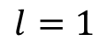
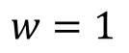
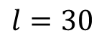
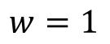
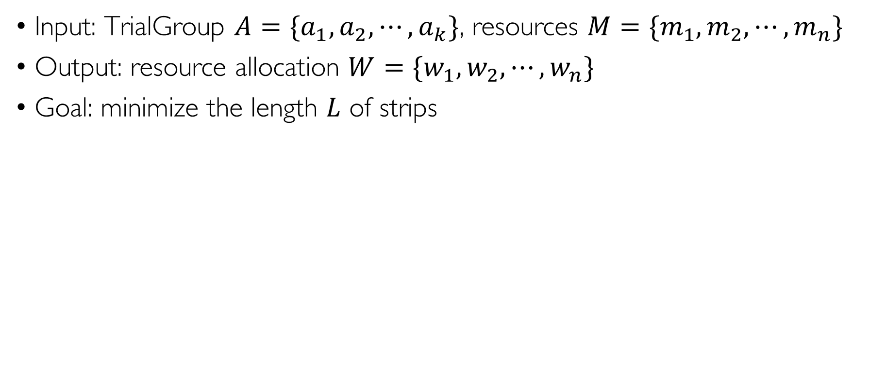
Problem Definition: Strip Packing
Input: TrialGroup $A=\{a_{1},a_{2},⋯,a_{k}\}$, resources $M=\{m_{1},m_{2},⋯,m_{n}\}$
Output: resource allocation $W=\{w_{1},w_{2},⋯,w_{n}\}$
Goal: minimize the length $L$ of strips
$$w=1$$
$$l=30$$
$$w=1$$
$$l=1$$
Motivations | Salus | Fluid | Orloj | Conclusion
Notes:
The next step is to find out how to minimize a trial group’s makespan while maximizing its resource utilization.
[click]
We formulate it as a strip packing problem: each job in the trial group is a strip, whose width is the number of resources allocated to it, and its length represents its execution time.
Therefore, for each trial , it’s possible to

Slide 51
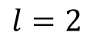
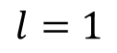
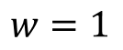
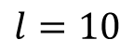
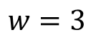
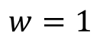
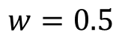
Problem Definition: Strip Packing
Input: TrialGroup $A=\{a_{1},a_{2},⋯,a_{k}\}$, resources $M=\{m_{1},m_{2},⋯,m_{n}\}$
Output: resource allocation $W=\{w_{1},w_{2},⋯,w_{n}\}$
Goal: minimize the length $L$ of strips
$$w=1$$
$$w=3$$
Inter-GPU
$$l=30$$
$$l=10$$
$$w=1$$
$$w=0.5$$
Intra-GPU
$$l=1$$
$$l=2$$
Motivations | Salus | Fluid | Orloj | Conclusion
Notes:
Therefore, for each trial , it’s possible to
Allocate a width larger than 1, making it a distributed training job.
Or on the other hand, assigning a fraction width to a trial makes it share the worker/GPU with other ones.
This strip packing problem is proved to be NP hard but Fluid needs to solve it fast in an online fashion, so we developed a heuristic algorithm that has bounded worst case guarantees.
Let me explain using a toy example.

Slide 52
Toy Example
4 trials (1 TrialGroup) scheduled on 5 workers
1
a₁
4
a₁
a₁
a₂
a₃
2
a₂
4
a₃
12
a₂
Worker
12
3
a₃
4
a₄
30
a₄
10
a₄
10
5
Default
Fluid
Optimal
Improves the resources utilization and mitigates the straggler
Motivations | Salus | Fluid | Orloj | Conclusion
Notes:
Here we have 4 trials scheduled on [click] 5 workers.
[click]
In the default settings, each trial takes its own worker and the makespan is 30 min.
[click]
This is how fluid will schedule it.
[click] Notice that the largest trial a4 will be trained distributedly on 3 workers and a1 and a2 are considered too small so fluid put them on the same worker.
[click]
For comparison, this is the optimal solution. Again, like I mentioned, fluid doesn’t solve the NP-hard optimization problem online, it uses a heuristic-based algorithm with proven worse case bound.
For further details about the algorithm and also how to apply that in the online settings, please refer to our paper.

Slide 53
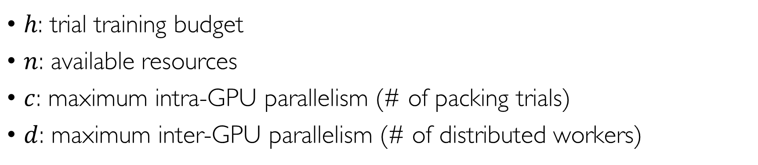
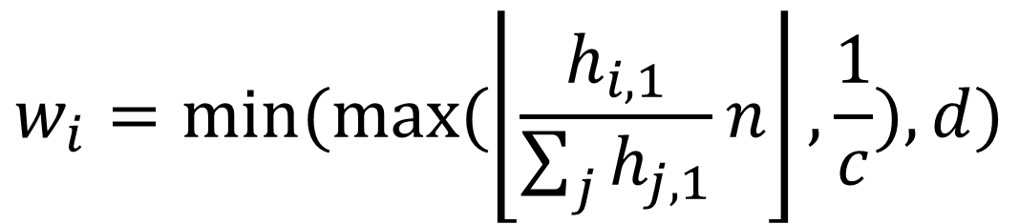
Algorithm: StaticFluid
$$w_{i}=min⁡(max⁡(\left\lfloor \frac{h_{i,1}}{\sum_{j}{h_{j,1}}}n\right\rfloor ,\frac{1}{c}),d)$$
Inter-GPU overhead
Budget ratio
$h$: trial training budget
$n$: available resources
$c$: maximum intra-GPU parallelism (# of packing trials)
$d$: maximum inter-GPU parallelism (# of distributed workers)
Intra-GPU overhead
Motivations | Salus | Fluid | Orloj | Conclusion

Slide 54
Evaluation Setup
Implementation: an alternative Ray^{[1]} executor
Workloads
Task | Base Model | # of Params. | Target
CIFAR-10 | AlexNet | 7 | Acc. >= 90%
WLM | RNN | 10 | PPL <= 140
DCGAN | CNN | 2 | Inception >= 5.2
[1]: https://github.com/ray-project/ray
Motivations | Salus | Fluid | Orloj | Conclusion
Notes:
We evaluate fluid on top of ray
And the workloads contain 3 tasks.
CNN model, 7 params
A language model with 10 params
Also tried fluid on a generative adversarial network with 2 parameters

Slide 55
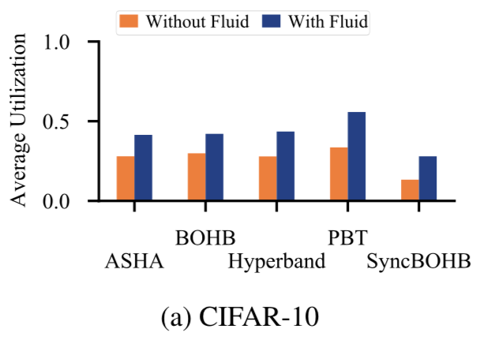
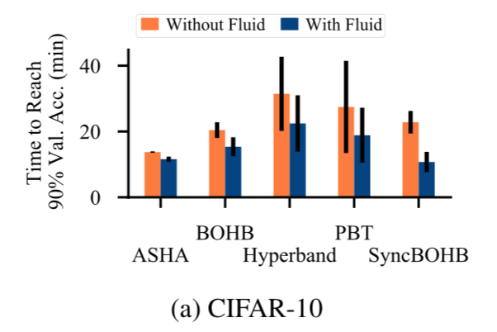
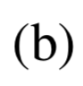
Evaluation Results
Average resource utilization: 10%-100% improvement
Average job completion time: 10%-70% improvement
Motivations | Salus | Fluid | Orloj | Conclusion
Notes:
On average, when combining Fluid with existing tuning algorithms, Fluid is able to achieve 10-100 percent improv in res util, and 10-70 percent improv in job completion time.

Slide 56
Evaluation Results: Visualization
Resource utilization over time
Time
Time
Time
Time
Motivations | Salus | Fluid | Orloj | Conclusion
Notes:
Let’s visualize this for the CIFAR-10 task
Recall the utilization heat map before.

Slide 57
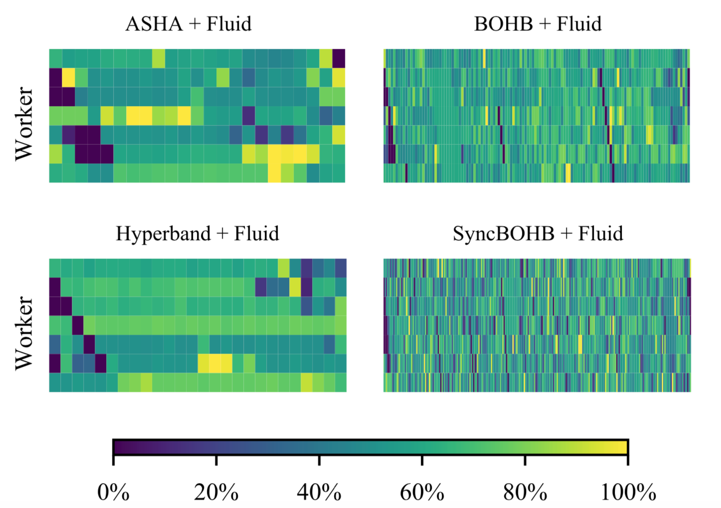
Evaluation Results: Visualization
Time
Time
Time
Time
Motivations | Salus | Fluid | Orloj | Conclusion
Notes:
With fluid, we see decent improvements in all cases.

Slide 58
Conclusion
Fluid
Hyperparameter tuning execution engine
Can be combined with most tuning algorithms
Improve utilization and end-to-end tuning time
Open source
https://github.com/SymbioticLab/fluid
Motivations | Salus | Fluid | Orloj | Conclusion
Notes:
In conclusion, Fluid is a hyperparameter tuning execution engine, that can be combined with most tuning algorithms, to improve utilization, and thus end-to-end tuning time.
It has also been open sourced on GitHub.

Slide 59
Outline
Salus
Fine-grained GPU Sharing Primitives for Deep Learning Applications
Fluid
Resource-aware Hyperparameter Tuning Engine
Orloj
Predictably Serving Unpredictable DNNs
Motivations | Salus | Fluid | Orloj | Conclusion
Notes:
Finally, let’s talk about Orloj

Slide 60
Orloj
Predictably Serving Unpredictable DNNs
Peifeng Yu, Yuqing Qiu, Xin Jin, Mosharaf Chowdhury
(Under submission)
Notes:
In this project, we question a common assumption in most serving systems: that request execution time is constant and data-independent,
And we build a system to meet tight latency constraints while maintaining high utilization.

Slide 61
DL Model Serving
Make DL model available as a service API
Serving system: handle inference requests to deployed models
Like other datacenter services – queue of incoming requests, scheduling
Service level objectives (SLOs) – must finish requests before the deadline
Utilization – don’t waste resources
Motivations | Salus | Fluid | Orloj | Conclusion
Notes:
So, inference serving, sits right on the opposite side of a model’s lifecycle as hyperparameter tuning we just talked about.
After having a pre-trained model, it is deployed as a service, so other applications, or services can use it to build larger and more complex business logics.
[click]
And the serving system that handles inference requests to those deployed models is no different than other datacenter services:
They need to deal with queue of pending requests, and decide which and when to run next,
[click]
These requests usually come with a service level objective SLO, meaning they must be finished before certain deadlines.
[click]
Of course, we can always meet the deadline if we simply allocate too many resources to the system, so another optimization target is utilization: we want to meet the deadline with as less resources as possible.
Let’s take a closer look at the general procedure of serving a request

Slide 62


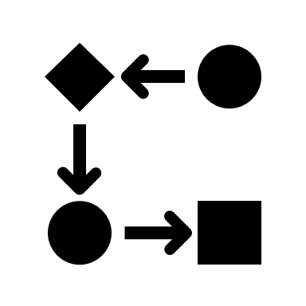





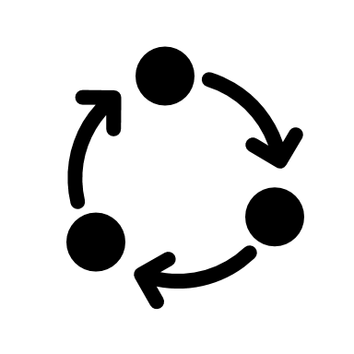
DL Model Serving
Model Serving
Application
API
1
Profiler
2
Batch
Size
Batch Latency
3
4
Batch
Scheduler
Worker
Motivations | Salus | Fluid | Orloj | Conclusion
Notes:
[click]
From the application, the system usually accepts requests in a priority queue, for example, sorted by deadline.
[click]
Then in order to improve utilization, requests are picked from the front of the queue to create a batch.
[click]
The scheduler will use information collected offline from the profiler to determine how long the batch will take to execute,
[click]
and derive an execution plan for worker.
Of course there isn’t exactly one way to divide work between the stages shown here, and there may be additional interactions between various components, but this should cover most of the interesting bits.
To finish up the whole picture, the setup can be scaled up to…

Slide 63
DL Model Serving
Model Serving
Application
API
1
Profiler
Constant
2
Batch
Size
Batch Latency
3
4
Batch
Scheduler
Worker
Motivations | Salus | Fluid | Orloj | Conclusion
Notes:
Multiple applications and servers.
Regardless, notice that the batch latency here is assumed to be a constant number.
This…

Slide 64
Constant Execution Time?
Constant
Assumption
Data-independent
Requests and batches have constant execution time
State derived from a single, point estimation of the batch latency
Makes sense for many tasks
DNN
CNN
What about dynamic networks?
Motivations | Salus | Fluid | Orloj | Conclusion
Notes:
highlights the major assumption in most serving systems: requests are input data independent, as such the active state in these systems are derived from a single, point estimation of the batch latency.
This certainly make sense for many tasks. For example, CNN networks for image classification don’t care the content of the image. It’s exactly the same computation whether the input is a dog or a cat.
But the assumption doesn’t hold for a new type of networks: those with dynamicity in the model.

Slide 65
Dynamic Neural Networks
Characteristics
Control flows
Dynamic data structures
Dynamic shapes
Inference requests are data dependent
NLP models -> depends on sequence length of the input/output
Cascade classification -> depends on image “difficulty”
Motivations | Salus | Fluid | Orloj | Conclusion
Notes:
That is to say, they have control flows, or dynamic data structures in their computation graph, or their inputs have dynamic shapes.
For them, inference requests are …
For example, many NLP models have varying execution time depending on the sequence length of the input, or the output.
And cascade classification selects different code paths depending on the image difficulty.

Slide 66
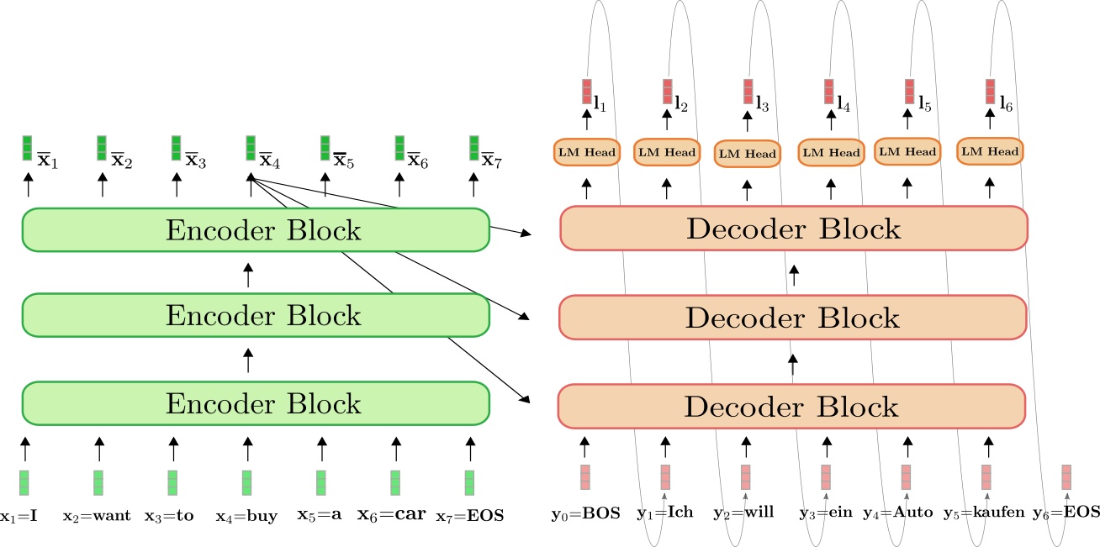
Transformer Illustrated
Image credit: https://huggingface.co/blog/encoder-decoder
Motivations | Salus | Fluid | Orloj | Conclusion
Notes:
As an easy to understand example, this is the well-known transformer architecture used in NLP, and you can see that
while it eliminates the looping part in its encoder blocks, its decoder blocks still need to run in a loop to produce the final sentence.

Slide 67
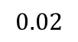
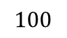
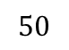
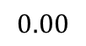
Existing Solutions
Probability
$$0.02$$
$$0.00$$
$$50$$
$$100$$
Input Exec. Time (ms)
Simple normal distribution
Motivations | Salus | Fluid | Orloj | Conclusion
Notes:
Let’s see how exactly existing state-of-the-art solutions work.
We’ll use requests whose true execution time is controlled, and sampled from a simple normal distribution.

Slide 68
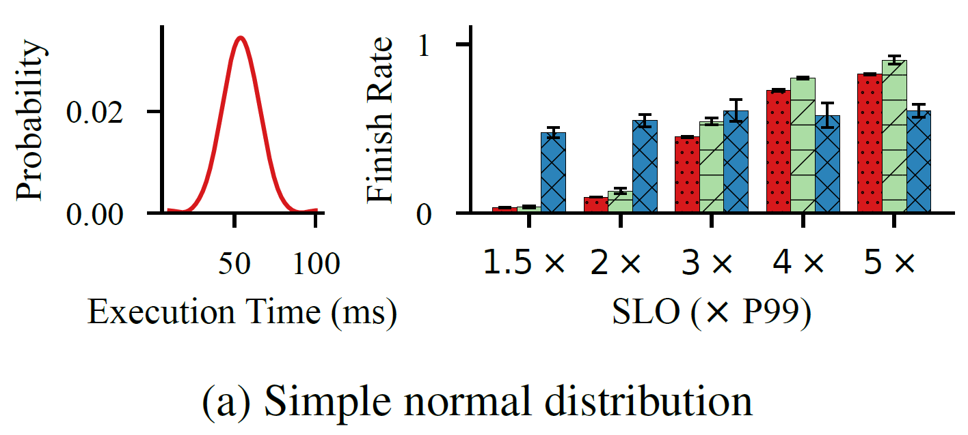
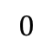
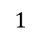
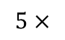
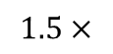
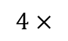
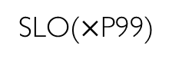
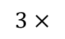
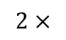
Existing Solutions
Clipper
Nexus
Clockwork
Probability
Finish Rate
$$1$$
$$0.02$$
$$0.00$$
$$0$$
$$50$$
$$100$$
$$1.5×$$
$$2×$$
$$3×$$
$$4×$$
$$5×$$
Input Exec. Time (ms)
SLO($×$P99)
Simple normal distribution
Motivations | Salus | Fluid | Orloj | Conclusion
Notes:
And we report the finish rate for different systems, under various SLO settings.
Since I’ll be using similar experiment setups many times in the rest of the talk, I’d like to spend some time to explain everything clearly.
Here, the execution time distribution is the input of the experiment, it controls how incoming requests’ true execution time are generated, and is unknown to systems under evaluation.
As for SLO, we set it to be multiples of the P99 of the execution time. This is similar to how SLOs are set in practice in real world, where they are usually derived from historical data.
Ok, with that out of the way, as we can see here, things are generally bad with very tight SLOs. While it’s getting better with increased SLO, the performance is suboptimal for all three systems.

Slide 69
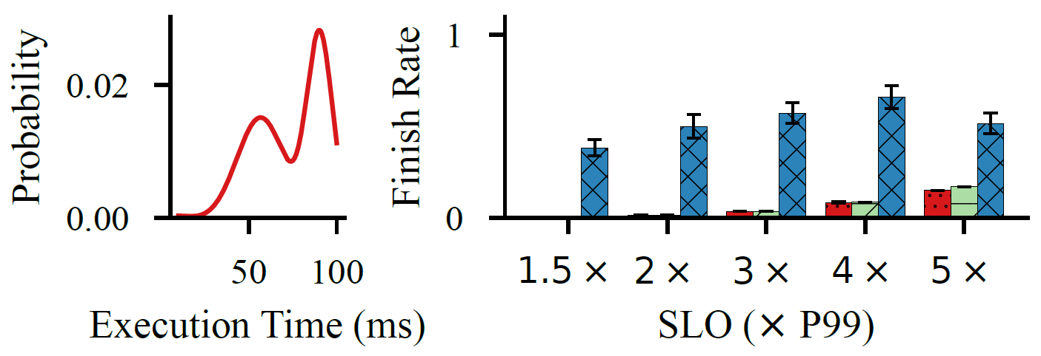
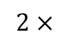
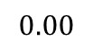
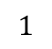
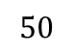
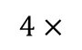
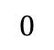
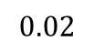
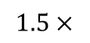
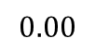
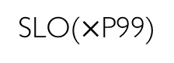
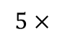













Existing Solutions
Clipper
Nexus
Clockwork
Probability
Finish Rate
$$1$$
Probability
Finish Rate
$$1$$
$$0.02$$
$$0.02$$
$$0.00$$
$$0$$
$$0.00$$
$$0$$
$$50$$
$$100$$
$$1.5×$$
$$2×$$
$$3×$$
$$4×$$
$$5×$$
$$50$$
$$100$$
$$1.5×$$
$$2×$$
$$3×$$
$$4×$$
$$5×$$
Input Exec. Time (ms)
SLO($×$P99)
Input Exec. Time (ms)
SLO($×$P99)
Simple normal distribution
Bimodal distribution w/ inequal peaks
Motivations | Salus | Fluid | Orloj | Conclusion
Notes:
And it’s getting worse when the request execution times follow something other than a simple normal distribution

Slide 70






















Existing Solutions
Reactive – can’t keep up with low latency
Clipper
Plan ahead – mis-predicted batch latency
Nexus
Clockwork
Single, point estimation of requests or batches no longer works
Clipper
Nexus
Clockwork
$$1$$
Probability
Finish Rate
$$0.02$$
$$0.00$$
$$0$$
$$50$$
$$100$$
$$1.5×$$
$$2×$$
$$3×$$
$$4×$$
$$5×$$
Input Exec. Time (ms)
SLO($×$P99)
Simple normal distribution
Probability
Finish Rate
$$1$$
$$0.02$$
$$0.00$$
$$0$$
$$50$$
$$100$$
$$1.5×$$
$$2×$$
$$3×$$
$$4×$$
$$5×$$
Input Exec. Time (ms)
SLO($×$P99)
Bimodal distribution w/ inequal peaks
Motivations | Salus | Fluid | Orloj | Conclusion
Notes:
The high-level take away is that single, point estimation of requests or batch execution time doesn’t work when serving dynamic networks.
Since we no longer know how long exactly the request will take,

Slide 71
How to minimize SLO violations
without complete knowledge of request execution time
while maintaining high utilization?
Notes:
How do we minimize SLO violations with such incomplete knowledge of request execution times?

Slide 72
Problem Definition
Request: release time, deadline
Scheduler picks requests from a set of pending requests to create batches
Constraints:
Partial information – unknown execution time
Non-preemption
– empirical distribution
Motivations | Salus | Fluid | Orloj | Conclusion
Notes:
To be precise about the problem definition: we want to serve requests that are released online, and have a deadline.
We want to pick requests from pending ones, to create batches
And the difficult part is that we don’t know how long the execution time is, and requests can not be preempted.
Fortunately we can still learn an empirical distribution of the execution time from historical data.

Slide 73
Intuition
Insufficient modeling of the request execution time
Constant → Random variable
Distribution-based scheduling
Motivations | Salus | Fluid | Orloj | Conclusion
Notes:
The intuition is that, if a constant number is insufficient to model the request execution time, then we just use something more expressive, say, random variables.
Then we could somehow use that distribution information in our scheduling algorithm.

Slide 74
Challenges
Batching
Varying request execution time → out-of-order batching (priority queue)
Request execution time affects each other in the batch → complex probability calc
Multimodal distribution
Requests coming from different applications
Mixture distribution with multi-modality → larger variance
Motivations | Salus | Fluid | Orloj | Conclusion
Notes:
Distribution-based scheduling has been studied in other areas, but for DL serving specifically, we have some unique challenges.
The first one is batching. While it is the common practice in DL serving to improve hardware utilization. Batching indeed complicates the matter a lot.
For example, as the request execution time varies, the batching order is not necessarily the same as the request arriving order,
And it may be better to first pick a shorter request for the current batch even though it arrives later than others.
This necessitates the use of priority queues.
Also more importantly, request execution affects each other in the same bath. They essentially starts and finishes at the same time, regardless of what each individual request’s original execution time is.
We therefore need to find a way to derive batch execution latency from request’s individual execution time distributions
Second, as a service, requests are coming from different applications. Therefore, they don’t necessarily follow the same distribution. The result is a mixture distribution with multi-modality.
That means large variance the scheduler needs to account for.

Slide 75

Orloj Architecture
2a
Priority Queue
Execution Time Distribution
Profiling
Dynamic Batching
Feedback
Batch
Scheduler
Worker
Motivations | Salus | Fluid | Orloj | Conclusion
Notes:
Let’s see how Orloj handles these.
Overall, Orloj follows similar steps as other model serving systems, but with different priority queue and batching policies.
To address the multimodal distribution challenge, Orloj annotates each requests with its originating application and associate each with a separate execution time histogram.

Slide 76
Orloj Architecture
2a
Priority Queue
Execution Time Distribution
Profiling
Dynamic Batching
Feedback
3a
2b
2c
Priority Score
Estimated Batch Latency
Batch
Scheduler
Worker
Motivations | Salus | Fluid | Orloj | Conclusion
Notes:
The histograms are combined to derive the distribution of batch latency, which is then used to calculate the priority score for each request.
Then requests at the front of the queue are selected to actually create the batch.

Slide 77
Orloj Architecture
2a
Priority Queue
Execution Time Distribution
Profiling
Dynamic Batching
Feedback
3a
2b
2c
Priority Score
Estimated Batch Latency
Estimated Batch Latency
Batch
3b
Scheduler
Worker
Motivations | Salus | Fluid | Orloj | Conclusion
Notes:
Along with the batch latency distribution, the information is passed to the scheduler, which decides when to actually run it.
Everything after that follows the same procedure as existing serving systems.

Slide 78

Batch-Aware Distribution-Aware Cost-based Scheduling
SLO → cost function $c=f\left(t\right)$
Priority score
Batch-aware
Distribution-aware
Time-varying
Maximize the expected cost reduction of executing a request now vs later
$$p\left(t\right)=\frac{1}{E{[L_{B}]}}\left(E{[C_{delay}\left(t\right)]}−E{[C_{now}\left(t\right)]}\right)$$
now
later
Motivations | Salus | Fluid | Orloj | Conclusion
Notes:
So obviously the core of Orloj is its priority score calculation.
[click]
In orloj, we do cost-based scheduling, and model the SLO as cost functions.
[click]
and we define a priority score that is batch-aware, distribution-aware, and changes over time.
The scheduler then makes decisions to maximize the expected …
I’ll leave the details of the equations and all derivations in the paper

Slide 79

Batch Latency Estimation
Requests in a batch are padded to the largest one
For batch $B$ of size $k$and request $r∈B$
$$E{[L_{B}]}=c_{0}+c_{1}kE{[\max_{r∈B}{L_{r}}]}$$
Requests follow the same distribution
Requests follow different distributions
Motivations | Salus | Fluid | Orloj | Conclusion
Notes:
https://www.wikiwand.com/en/Order_statistic#/Cumulative_distribution_function_of_order_statistics

Slide 80





Toy Example
Cost
$$c$$
$$0$$
$$T$$
$$D$$
Time
Cost function
Motivations | Salus | Fluid | Orloj | Conclusion
Notes:
And use a toy example to illustrate the basic points.
Suppose we have a simple cost function like this, which means if the request is finished any time between T and D, there is 0 cost. And if we ever miss the deadline D, there will be a cost c.

Slide 81







Toy Example
$$0.5$$
Frequency
$$0.0$$
$$0.5$$
$$0.0$$
$$0$$
$$l$$
$$20$$
Execution time (ms)
Execution time of two types of requests
Motivations | Salus | Fluid | Orloj | Conclusion
Notes:
And further assume that there are two kinds of requests.
They both have the same mean execution time, but one has higher variance that the other.

Slide 82













Toy Example
$$0.5$$
$$0.6$$
Frequency
$$0.4$$
$$0.0$$
$$0.5$$
$$0.2$$
$$0.0$$
$$0.0$$
$$0$$
$$l$$
$$20$$
$$0$$
$$20$$
Execution Time (ms)
Execution Time (ms)
Execution time of two types of requests
Execution time for the batch (size=2)
Motivations | Salus | Fluid | Orloj | Conclusion
Notes:
From these, we can derive the distribution of the batch latency if we were given the batch size is 2

Slide 83









Toy Example
$$r_{1}$$
Score
$$r_{2}$$
$$r_{3}$$
$$T$$
$$T′$$
$$T′′$$
$$D_{1}$$
$$D_{2}$$
$$D_{3}$$
Time
Motivations | Salus | Fluid | Orloj | Conclusion
Notes:
And finally, there are 3 requests, coming from either distributions over time. This shows how their relative priorities changing over time.
Request r1 arrives first and has deadline D1, then followed by r2 with deadline d2, and r3 with deadline d3.
If we inspect at time T, r1 and r2 should be picked to create the batch.
However at a later time T’, it becomes r1 and r3 that are better candidates.
Finally, at T’’, the priority of r1 drops to near zero, and we should pick r2 and r3.
So that is core idea of distribution-based and time-varying priority score.

Slide 84
Evaluation
4000 lines of C++
Impl. based on Clockwork
Intel Xeon Gold 6230
NVIDIA V100 GPU
Improvements over the state-of-the-art
Traditional static workloads
Overheads
Notes:
Let’s turn to evaluation.
Orloj is implemented in ~4000 lines of C++ code based on Clockwork.
And we want to verify
its improvements over the state-of-the-art solutions on dynamic workloads,
its performance on static workloads,
Also we want to evaluate its overhrads

Slide 85















Improvements over SOTA
Clipper
Nexus
Clockwork
Orloj
$$200$$
$$1.0$$
Frequency
Finish Rate
$$100$$
$$0.5$$
$$0$$
$$0.0$$
$$2.5$$
$$5.0$$
$$7.5$$
$$1.5×$$
$$2×$$
$$3×$$
$$4×$$
$$5×$$
Incoming Exec. Time (ms)
SLO($×$P99)
SkipNet/ImageNet
Motivations | Salus | Fluid | Orloj | Conclusion
Notes:
Due to limited time, I’ll only report very few selected results. More is included in the thesis.
This first set of experiments compares Orloj against others on SkipNet, a dynamic image classification network the can skip layers.
Recall that request execution time distribution shown on the left is the input to the experiment, used to generate incoming request traces that are shared by all systems.
and we report the finish rate on such traces on the right.
Orloj significantly outperforms all 3 baselines under all SLO conditions.

Slide 86



























Improvements over SOTA
Clipper
Nexus
Clockwork
Orloj
$$200$$
$$1.0$$
$$50$$
$$1$$
Frequency
Finish Rate
Frequency
Finish Rate
$$100$$
$$0.5$$
$$0$$
$$0.0$$
$$0$$
$$0$$
$$2.5$$
$$5.0$$
$$7.5$$
$$1.5×$$
$$2×$$
$$3×$$
$$4×$$
$$5×$$
$$50$$
$$100$$
$$1.5×$$
$$2×$$
$$3×$$
$$4×$$
$$5×$$
Incoming Exec. Time (ms)
SLO($×$P99)
Incoming Exec. Time (ms)
SLO($×$P99)
SkipNet/ImageNet
BART/Synthesized Dataset
Finish 51-80% more requests under tight SLO constraints
Over 100% under more relaxed settings
Motivations | Salus | Fluid | Orloj | Conclusion
Notes:
Then there’s the BART model. We use a synthetic input with a bimodal distribution. Again Orloj shows great improvement over other solutions.
. Overall, Orloj finishes …, and the improvements can be over …

Slide 87























Traditional Static Workloads
Clipper
Nexus
Clockwork
Orloj
Frequency
$$1000$$
Finish Rate
Frequency
$$1000$$
Finish Rate
$$1$$
$$1$$
$$0$$
$$0$$
$$0$$
$$0$$
$$45.0$$
$$45.5$$
$$1.5×$$
$$2×$$
$$3×$$
$$4×$$
$$5×$$
$$51.5$$
$$52.0$$
$$1.5×$$
$$2×$$
$$3×$$
$$4×$$
$$5×$$
Incoming Exec. Time (ms)
SLO($×$P99)
Incoming Exec. Time (ms)
SLO($×$P99)
Inception V3/ImageNet
ResNet/ImageNet
Comparable performance against SOTA
Motivations | Salus | Fluid | Orloj | Conclusion
Notes:
Those improvements on dynamic networks doesn’t sacrifice Orloj’s performance on traditional, static workloads.
As the evaluation results show on Inception and ResNet, Orloj has comparable or slightly better performance in most cases.

Slide 88












Overheads
SLO
$$1.5×$$
$$2×$$
$$3×$$
$$4×$$
$$5×$$
$$1.00$$
Finish Rate
$$0.75$$
$$0.50$$
$$20$$
$$40$$
$$60$$
$$80$$
P99 of True Execution Time (ms)
Motivations | Salus | Fluid | Orloj | Conclusion
Notes:
Finally, we try to push Orloj to its limit and vary the P99 of true request execution time and measure Orloj’s finish rate.
Basically, requests are becoming shorter and shorter as the P99 decreases.
Orloj keeps stable performance until the P99 approaching 20ms. At that time, due to variance in the execution time, the mean approaches 10ms and request can go as low as less than 2ms.

Slide 89
Orloj
Predictably Serving Unpredictable DNNs
Break the assumption of constant, data-independent execution time
Probability theory derived batch latency estimation
Batch-aware distribution-aware cost-based scheduling
Outperform SOTA on dynamic workloads
Notes:
So that concludes Orloj.
It is our attempt to break the assumption that …
And use probability theory to derive batch latency from individual requests’ empirical distributions
We then perform batch-aware…
And we can beat state-of-the-art on most dynamic workloads.

Slide 90
Conclusion
Salus
Fine-grained GPU Sharing Primitives
Fluid
Resource-aware Hyperparameter Tuning
Orloj
Predictably Serving Unpredictable DNNs
Fluid
Hyperparameter Tuning
Data Preprocessing
Orloj
Model Serving
High-level
Model Training
DL Framework/Compiler/Runtime
Low-level
Salus
Hardware
CPU
GPU
TPU
ASIC
…
Motivations | Salus | Fluid | Orloj | Conclusion
Notes:
To wrap (/rap/) up,
Salus provides fine-grained GPU sharing primitives, and targets the mismatch between low-level framework and the hardware
Fluid reduces the gap between HP applications and the cluster resource scheduler by implementing a dedicated execution engine for tuning jobs.
Orloj is a model serving system that uses distribution-based scheduling algorithm to handle the emerging dynamic neural networks.
Collectively, they attempt to address some mismatches we found in the software stack, and hope they can lead to more efficient systems in the DL infrastructure.

Slide 91
Acknowledgement
All the people who helped me during my PhD
Prof. Mosharaf Chowdhury
Motivations | Salus | Fluid | Orloj | Conclusion
Notes:
Before answering questions, I’d like to thank all the people who helped me during my PhD. I won’t be in today’s position without their valuable support.
I wish I could name all of them, but due to time limitations, I can’t.
However, I still want to give my special thanks to Mosharaf. He is a great advisor, always believing in me and inspiring me to move forward. I really appreciate that.
With that, I’m ready to take questions.

Slide 92
Q&A
Thank You
Motivations | Salus | Fluid | Orloj | Conclusion
Notes:
Before answering questions, I’d like to thank all the people who helped me during my PhD. I won’t be in today’s position without their valuable support.
I wish I could name all of them, but due to time limitations, I can’t.
However, I still want to give my special thanks to Mosharaf. He is a great advisor, always believing in me and inspiring me to move forward. I really appreciate that.
Finally, today is actually very special, in that
it’s the mother’s day this Sunday and my mom is also listening right now. I would like to take this special moment to wish her happy mother’s day. I love you mom! 妈妈 我爱你！
With that, I’m ready to take questions.

Slide 93
Limitations
Salus
No enforcement of computation scheduling decisions due to performance reasons
Assuming cooperative environment
Fluid
Requiring algorithm opt-in to TrialGroup
No locality
Orloj
Limited use of per-application distribution
Motivations | Salus | Fluid | Orloj | Conclusion

Slide 94
Future Work
Best scheduling algorithm for DL jobs?
Automated execution strategy selection for general DL training jobs
Serving dynamic model in pipeline
Efficient dynamic model execution
Motivations | Salus | Fluid | Orloj | Conclusion

Slide 95


Request Execution Time Varies Widely
RDI-Nets
SkipNet
Notes:
Here are some examples. These are the execution time histograms where X-axis is the time it takes to finish one inference request for the model. Y-axis is the frequency that such time happens.
Please note that the absolute number of requests in these histograms are less important, as it merely represents the testing dataset we used.
However, the existence of a large range of values in the x-axis reflects the possibility of distinct code paths. That is because different inputs trigger different parts or layers in RDI-Nets and SkipNet, which are two dynamic image classification models and they can skip or activate parts of the model depending on the input image.

Slide 96


Request Execution Time Varies Widely
RDI-Nets
GPT
SkipNet
BART
Notes:
We also have similar results for NLP models. Of which GPT and BART are pretty well-known and popular ones.
For them, instead of distinct bins, the execution times fall into a continuous range, because their execution time depends on the input and output sequence length, which is continuous in our dataset.

Slide 97


Request Execution Time Varies Widely
RDI-Nets
GPT
Inception V3
SkipNet
BART
ResNet
Notes:
Here are some examples. These are the execution time histograms where X-axis is the time it takes to finish one inference request for the model. Y-axis is the frequency that such time happens.
Please note that the absolute number of requests in these histograms are less important, as it merely represents the testing dataset we used.
However, the existence of a large range of values in the x-axis reflects the possibility of distinct code paths. That is because different inputs trigger different parts or layers in RDI-Nets and SkipNet, which are two dynamic image classification models and they can skip or activate parts of the model depending on the input image.
We also have similar results for NLP models. Of which GPT and BART are pretty well-known and popular ones.
For them, instead of distinct bins, the execution times fall into a continuous range, because their execution time depends on the input and output sequence length, which is continuous in our dataset.
Finally, for comparison, this is what it looks like for static models: inception v3 and resnet.
As you can see, their execution time are quite stable and clustered around a single number.

Slide 98
Relation to Unknown Size Job Scheduling
Unknown size job scheduling in cluster
Age-based: MLFQ, (M/G/1 queue, SOAP)
Difference: job vs request
Time scale: a few minutes vs. a few milliseconds
Sustained – Short time
Preemptable – Non-preemptable
Notes:
Well that sounds like a familiar problem in the field of cluster scheduler
There is a large body of work on unknown size job scheduling in cluster. The popular solution is to use an age based scheduler, which bases the scheduling decision on how long the job has run in the system.
But our problem is actually different: ….
So that rules out the possibility of all age-based scheduling.

Slide 99

Parameter Sensitivity

Slide 100

Batch-aware Distribution-aware Cost-based Scheduling
Priority score: $p_{q}\left(t\right)=\frac{1}{E\left[B\right]}\left(E\left[C_{delay}\left(t\right)\right]−E\left[C_{now}\left(t\right)\right]\right)$
Expected batch latency (batch size k):
$$E\left[B\right]=ωnE\left[\max_{r∈B}{r}\right]=ωn\int_{r=0}^{∞}{\left(1−F_{R_{(k)}}\left(r\right)\right)ⅆr}$$
CDF of max order statistics of R: $F_{R_{(k)}}\left(r\right)={\left[F_{R}\left(r\right)\right]}^{k}$
CDF of R (can approx. from histogram): $F_{R}\left(r\right)$
Max order statistics over k random variables that are independent, no-identical distributed.

Slide 101

From Request to Batch
Batches are run as if all requests in it has the length of the largest request
Batch latency = $α∙n∙\max_{len}{\text{Reqs} \text{in} \text{batch}}$
First find the largest order statistics of the sample distribution
Can be calculated given CDF
Notes:
Scheduler schedules batches so we need batch latency

Slide 102
DNN Performance Modeling
Prediction of training job duration
Variability comes from many external factors (OS, data prep, framework hidden overhead, hardware configurations etc)
Predict when job will stop is hard
Dedicated ML model to predict
Gao, Yanjie, Xianyu Gu, Hongyu Zhang, Haoxiang Lin, and Mao Yang. “Runtime Performance Prediction for Deep Learning Models with Graph Neural Network,” n.d., 12.
Optimus, eurosys’18
Other related
Usually extracting model static architecture (not dynamic neural network aware)
Paleo: A Performance Model for Deep Neural Networks
Predicting the Computational Cost of Deep Learning Models
Predict GPU utilization, memory
Prediction of general graph execution using ML
I. Pietri, G. Juve, E. Deelman and R. Sakellariou, "A Performance Model to Estimate Execution Time of Scientific Workflows on the Cloud," 2014 9th Workshop on Workflows in Support of Large-Scale Science, 2014, pp. 11-19, doi: 10.1109/WORKS.2014.12.

Slide 103
DNN Performance Modeling
Inference environment is more controlled
A few possible execution paths
Dynamicity comes from control flows in network
Deactivate/activate certain part of the network
Loops

Slide 104
DNN Performance Modeling
Using a histogram (buckets) describing the distribution of likely request length rather than a single point estimate of the true running time
Predicting the request length for a particular request is hard, but the distribution can be reasonably learned

Slide 105

Why knowing distribution is useful?
q2 is more urgent due to higher chance to miss deadline
Relative importance changes over time
When deadline is d’: q1 is more urgent
When deadline is d’’: q2 still valuable

Slide 106



Distribution-based SLA Scheduling
Cost-aware Scheduling
Optimize costs (utility)
Add expectation into the equation: Shepherd priority score
Chi, Yun, Hakan Hacígümüş, Wang-Pin Hsiung, and Jeffrey F. Naughton. “Distribution-Based Query Scheduling.” Proceedings of the VLDB Endowment 6, no. 9 (July 1, 2013): 673–84. https://doi.org/10.14778/2536360.2536367.
Notes:
Executing a request now has cost such resource usage and opportunity cost (may postpone other requests),
Executing it later may also have monetary penalty due to SLA

Slide 107


Distribution-based SLA Scheduling
For a single bucket of length [r1,r2), deadline d, cost c after ddl
Generalize to ith bucket and jth step in cost function

Slide 108

Distribution-based SLA Scheduling
Cost-aware Scheduling
Optimize costs (utility)
Add expectation into the equation: Shepherd priority score
Convert time-varying score to dual space and use efficient convex hull algorithm at runtime to obtain the highest priority request O(log²N)
Chi, Yun, Hakan Hacígümüş, Wang-Pin Hsiung, and Jeffrey F. Naughton. “Distribution-Based Query Scheduling.” Proceedings of the VLDB Endowment 6, no. 9 (July 1, 2013): 673–84. https://doi.org/10.14778/2536360.2536367.
Notes:
Executing a request now has cost such resource usage and opportunity cost (may postpone other requests),
Executing it later may also have monetary penalty due to SLA

Slide 109
Batch-aware Distribution-aware Cost-based Scheduling
Given a request distribution R
Precompute E[B] for all model’s supported batch sizes
Plug in equation mentioned previously to compute score
Select top k to form a batch

Slide 110
Summary
No more NLP specific, can apply to any dynamic NN
Use histogram of request length, V-optimal algo
Compute modified Shepherd priority score, select top k to form batch
Over/underestimation handling still apply
Can be viewed as implementation details
Contribution
Identify the serving problem of dynamic NN
Adapt Shepherd algorithm in the context of NN serving with batching
Implement such algorithm efficiently with V-optimal histogram and misestimation handling

Slide 111

Case Study: Lack of Elasticity Reduces Util.
Successive Halving (SHA)
# of workers is static
Each trial uses one worker
# of trials is diminishing
# Workers | Utilization | Runtime(s)
2 | 81.2% | 2356
4 | 63.0% | 1432
8 | 45.8% | 1073
16 | 47.0% | 475
32 | 25.2% | 432
Utilization of Successive Halving (Synchronous)
Right figure by: Liam Li, https://blog.ml.cmu.edu/2018/12/12/massively-parallel-hyperparameter-optimization/
Notes:
In this case study, we are tuning a simple classification model using synchronous SHA
We assume # worker is static, each trial uses exactly one worker
As shown in the left figure, there will be 4 stages, where each stage will choose the best one third of its previous stage’s trials and spend more resources on them
So # of trials is diminishing
It’s already clear from the figure that there aren’t enough trials to keep workers busy at later stages of the algorithm,
And quantitively, this table shows the avg util given different # of workers.
It’s obvious that the lack of elasticity is the problem. If distributed training were used, and training trials can be elastically scale up when there are idle workers, it will greatly improve the utilization.

Slide 112

Case Study: High Utilization != Useful Work
Simply way to parallelize: always ensure enough trials to saturate the cluster
Asynchronous SHA (ASHA): trial concurrency == # of workers
Can not scale up beyond a certain # of workers
Notes:
Ok, that’s just a naïve way to implement the algo, you may say, we can easily increase the # of trials to saturate the cluster, without the hassle of elastic distributed training
That’s the technique used in ASHA, async SHA. Which is similar to SHA, but keeps adding new trials to the base stage, as long as there are idle workers.
So there are always n trials running given n workers.
We track the best val. acc over wall clock time & GPU sec
Beyond a certain point, adding more workers doesn’t speed up the algorithm anymore,
and even though the cluster is still fully utilized, those busy workers are not doing anything useful toward the end goal

Slide 113
Goals
Challenges
State-of-the-art resource efficiency
Inter-GPU: distributed training
Intra-GPU: Nvidia MPS
Apply to most tuning algorithms
React to cluster resource changes
The wide variety of algorithms
Algorithm-awareness
Dynamic environment
Trial add & removal
Resources add & removal
Heterogeneity in trial profiles
Nonpredictable iteration time
Notes:
With Fluid, we want to achieve the following goals,
1.
2.
3.
Given these goals, it’s not a trivial task to build such an engine
First of all, … makes it hard to maintain algo-awareness, such that we can still make decisions based on rich algorithm level info
Second, both trials and res can be added & removed at any time, making resource planning challenging
Last, HP may change the structure of the model, so the training iteration time can’t be easily predicted, and we basically have a heterogeneous bag of trial to schedule
So let’s welcome Jiachen. She will introduce the TrialGroup abstraction and how our algorithm solve the challenges.

Slide 114
Resource Parallelism
1. Intuition: More trials than resources
Intra-GPU parallelism: NVIDIA MPS
2. Intuition : More resources than trials
Inter-GPU parallelism: distributed training/elastic resource
How to account for overhead ?
Marginal benefit assessment
Notes:
How fluid execute these trial groups to achieve higher performance is through leveraging parallelism

Slide 115

Algorithm: DynamicFluid
$$w_{i}=min⁡(max⁡(\left\lfloor \frac{h_{i,1}}{\sum_{j}{h_{j,1}}}n\right\rfloor ,\frac{1}{c}),d)$$
Minimize the makespan of multiple TrialGroups
Dynamically changing resources
Notes:
Even difficult
Refer to paper

Slide 116
Salus in One Slide
Salus
Create session
Send computation graph
For each iteration:
Send input
Check memory
Queue in scheduler
User Script
User Script
…
DL Framework
DL Framework
…
Salus Adaptor
Salus Adaptor
Session
Scheduler
Memory Manager
GPU

Slide 117
Sharing Primitives: Memory Sharing
Efficient job switching
Memory sharing: GPU lane
GPU lane
Deep Learning Frameworks
= Continuous physical memory + GPU stream
Time-slicing within lane, parallel across lanes
Dynamic re-partitioning (lane assignment)
Avoid in-lane fragmentation

Slide 118


GPU Lane: Best Fit & Safety Condition
A lane cannot accept arbitrary number of jobs
The Safety Condition determines whether a job can go in a lane
$$\sum_{i}{P_{i}}+\max_{i}{T_{i}}≤C_{l}$$
$P_{i}$: Model and framework-internal memory for job $i$
$T_{i}$: Ephemeral memory for job $i$
$C_{l}$: Memory capacity of lane $l$

Slide 119

GPU Lane: Best Fit & Safety Condition
A lane cannot accept arbitrary number of jobs
The Safety Condition determines whether a job can go in a lane
$$\sum_{i}{P_{i}}+\sum_{i}{T_{i}}≤C_{l}$$
Static Partitioning:
$P_{i}$: Model and framework-internal memory for job $i$
$T_{i}$: Ephemeral memory for job $i$
$C_{l}$: Memory capacity of lane $l$

Slide 120
Salus Scheduling Polices
FIFO is suboptimal
HOL blocking
Underutilization
With Salus
Packing: achieves higher utilization
Preemption: enables prioritization
Fairness: equalizes the resource usage
…
What’s more?
Still a huge design space!

Slide 121
Overhead

Slide 122
Sub-second Level Switching
Slice of the 100 job trace, time is normalized
Sub-second switching
Notes:
TODO: CDF of 100 job trace

Slide 123
Salus Enable Fast Switching in SRTF
2 slices of the 100 job trace
Time is normalized
Notes:
TODO: CDF of 100 job trace

Slide 124
Overhead

Slide 125
#1
Codebase Optimization
Minimize overhead
Stable interface for policies
#2
Multi-Device Support
Automatic device placement with DAG scheduling
Computation devices across RDMA network
Three
Followups
#3
Unified Internal Representation
For easier integration of frameworks & Salus
Notes:
General-purpose coflow scheduling raises many challenges, and at least four remain unanswered in this work.
First, how to handle dependencies between multiple stages of a data-parallel job and multiple waves of a data-parallel job.
Second, how to emulate smallest-first scheduling without knowing flow sizes or the number of flows.
Third, how to handle master failure and support low latency coflows?
Baraat addresses all three in the context of tasks, i.e., in the context of point-to-multipoint or multipoint-to-point coflows.
For data-parallel jobs, a more scenario is multipoint-to-multipoint scenario where matching plays an important role in addition to ordering.

Slide 126
Schedule at GPU Kernel Level?
Central kernel-based scheduler
Breaks common efficiency optimizations: kernel batching and pipelining
Ephemeral allocation is not atomic!

Slide 127
Schedule at GPU Kernel Level?
Central kernel-based scheduler
Breaks common efficiency optimizations: kernel batching and pipelining
Ephemeral allocation is not atomic!
12 GB
Job A/B: 1 GB persistent, 7 GB temporary
P_{B}+= 1 GB
T_{B}+= 2 GB
Job X allocates n GB model memory
T_{B}+= 2 GB
P_{X}+= n GB
T_{A}+= 3 GB
T_{B}+= 3 GB
Job X allocates n GB ephemeral memory
T_{A}+= 2 GB
T_{X}+= n GB
T_{A}+= 2 GB
0 GB
P_{A}+= 1 GB
Time

Slide 128

In-Lane Memory Fragmentation
In-lane Fragmentation

Slide 129
GPU Lane: Allocation
An event-driven algorithm: reacts when job arriving / finishing
If possible to create new lane -> create
If possible to reuse existing one -> reuse
If possible to defrag -> defrag
Otherwise, wait

Slide 130
Multi-GPU: the Rescue or Nightmare?
Data parallelism
Model parallelism
Parameter server? Communication?
Ad-hoc memory aggregation
Modify model to fit in the memory
→ Worse memory under-utilization
ML practitioners always have to deal with low-level hardware details. No clean separation of concerns.
Notes:
This is one of the major reaons for memory underutilization issue in cluster.
Most of time, more than 80% memory is allocated to applications.
However, the actually usage is lower than 50%.
Users/ Applications are requesting extra memory to protect their performance.
Large portion of memory is not utilized, although they are allocated.
How can we use this part memory?
To protect their performance. Their
Each machines are having different free memory
And the used memory are imbalanced across the cluster
High priority
Middle priority
Low priority
12k machines

Slide 131
They Don’t Even Care!
Expectation's from ML practitioners
Handle larger model and data
Mix & match networks and layers
Something smart and just runs
Improve application performance and cluster efficiency
Minimize deployment overhead
No new hardware
No software modification
Tolerate failures
Machine crash, network disconnection
Manage remote memory at scale
as efficient/convenient as possible
Average memory usage less than 50%
Peak-to-average ratio as high as 4.86x
GPU allocation: one or nothing
Notes:
This is one of the major reaons for memory underutilization issue in cluster.
Most of time, more than 80% memory is allocated to applications.
However, the actually usage is lower than 50%.
Users/ Applications are requesting extra memory to protect their performance.
Large portion of memory is not utilized, although they are allocated.
How can we use this part memory?
To protect their performance. Their
Each machines are having different free memory
And the used memory are imbalanced across the cluster
High priority
Middle priority
Low priority
12k machines

